Slide 1


Slide 2

Tutorial 5 Sections 009/010
TA: Greydon Gilmore
Physiology 2130
Oct 8th, 2019

Slide 3

Your TA reminding you…
1st Peerwise assignment (1.5%)
Post 2 MC questions: due Oct 16th @ midnight (next Wednesday!)
Answer 5 MC questions: due Oct 18th @ midnight
22 students completed
27 students have answered at least 5
1st Quiz (1%)
Opens: Oct 21st @ 4pm
Closes: Oct 22nd @ 4pm
1st Midterm - Oct 25th @ 6pm-7pm (15%)
Midterm Review session
When: Tuesday, Oct 22nd from 6:00-8:00pm
Where: Auditorium B, University Hospital, 3rd floor

Slide 4
Today
Group work
Learning Catalytics Question
Nervous system overview
Touch

Slide 5
Group Work

Slide 6
Sensory Case Study
Steven is a 21-year-old male that has just been involved in a car accident where his car was hit broadside as he drove through a busy 4-way stop intersection in the evening on his way home from school. Although relatively unharmed, since Steven lost consciousness for a short period of time at the scene of the accident, the emergency room staff admitted him to evaluate if any head trauma occurred. Steven does not wear prescription glasses although he is red/green colour blind; he has no history of seizures and does not take any medication.

Slide 7
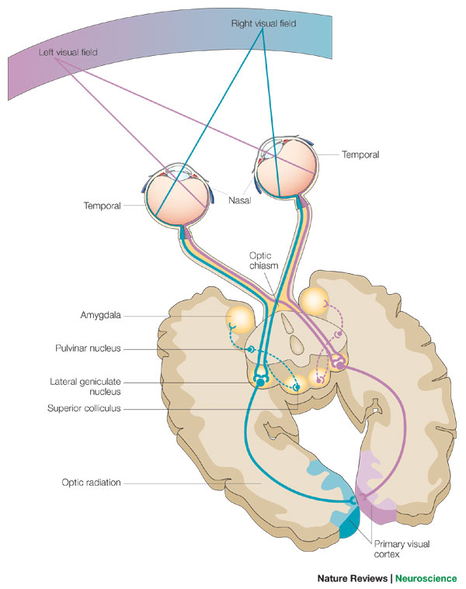
Sensory Case Study
After a physical assessment and an MRI of his head, Steven was diagnosed with an intracranial tumor that affected his peripheral vision in both eyes

Slide 8
Sensory Case Study
Where is the likely location of the tumor that causes the loss of peripheral vision in both eyes of the patient? Explain why.
What if Steven could not see the right half of his visual world. What lesion(s) could cause that problem?
What kind of damage would have to occur to make someone completely blind?

Slide 9
Sensory Case Study
Where is the likely location of the tumor that causes the loss of peripheral vision in both eyes of the patient? Explain why.
Vertical across optic chiasm
What if Steven could not see the right half of his visual world. What lesion(s) could cause that problem?
left optic tract, left LGN, left optic radiation, left primary visual cortex
What kind of damage would have to occur to make someone completely blind?
Horizontal across optic chiasm
Damage both right and left thalamus
Damage both right and left visual cortex
Damage to both retinas
Severing both optic nerves

Slide 10
Learning Catalytic Question

Slide 11
Nervous System Overview
Chapter 2: Dr. Everling
pp.

Slide 12
Divisions of the Nervous System

Slide 13
Anatomical Terms of Location

Slide 14
Anatomical Planes of Section
Sagittal: Divides left and right
Horizontal: Divides superior and inferior
Coronal: Divides anterior and posterior

Slide 15
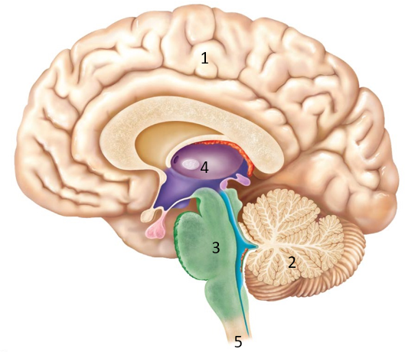
CNS Major Parts and Functions
1. Cerebrum
Cortex, basal ganglia, limbic system
Contralateral sensation and movement
2. Cerebellum
Ipsilateral motor function
3. Brain Stem
Medulla oblongata, pons, midbrain
Life functions (ex: respiration)

Slide 16
CNS Major Parts and Functions
4. Spinal Cord
Conduit for information
5. Diencephalon
Thalamus, Hypothalamus, pineal gland, pituitary gland

Slide 17
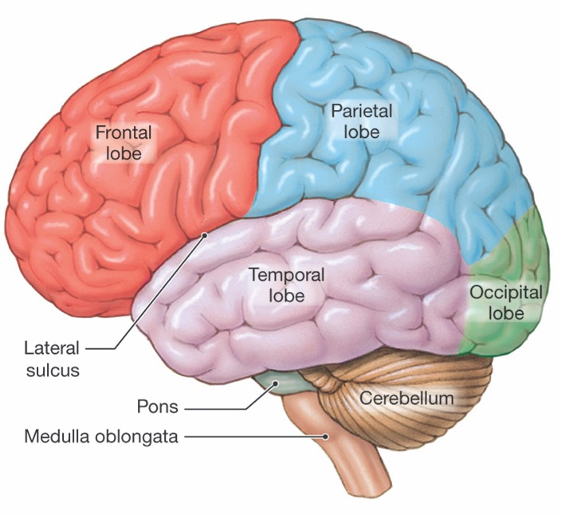
CNS: Lobes of the Cerebral Cortex
Central Sulcus

Slide 18
White vs. Grey Matter
 | White Matter | Grey Matter
Colour | White | Grey
Components | Axons | Cell bodies, dendrites and axon terminals
Myelin present | Yes, gives white appearance | No
Function | For communication between grey matter sites | Processing of information

Slide 19
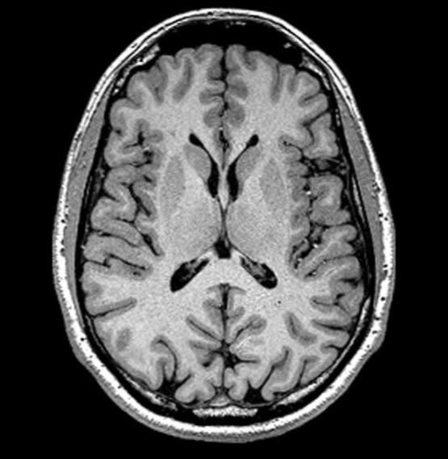
White vs. Grey Matter
Gray Matter
White Matter

Slide 20
CNS: The Spinal Cord
White and gray matter are opposite to the brain (spinal cord: white external and grey internal)
31 segments
Each segment has a pair of spinal nerves (PNS) – 31 pairs of spinal nerves
Each segment receives sensory info and sends motor info to a similar region
On the skin, the sensory region is called a dermatome

Slide 21
PNS: Spinal Nerves
Sensory information is carried TOWARDS (afferent neuron) the spinal cord through the dorsal root
Motor information is carried OUT (efferent) the spinal cord through the ventral root
“SAME DAVE” sensory afferent motor efferent dorsal afferent ventral efferent

Slide 22
PNS: Divisions: Somatic vs. Autonomic
Somatic
Conscious Sensation
Voluntary Movement
Spinal Nerves
Autonomic (Visceral)
Involuntary Actions
Sympathetic vs Parasympathetic Response

Slide 23
Somatosensation (Touch)
Chapter 2: Dr. Everling
pp.

Slide 24
Definitions
Threshold: minimum stimulus required to activate a receptor
Adaptation rate: the time it takes for a receptor to get used to the stimulus (i.e. when a mechanoreceptor receives a stimulus, it begins to fire APs at an elevated frequency. Eventually, the receptor adapts to that stimulus and the firing of the AP stops (or decreases))
Receptive field: the region of sensory space in which a stimulus will activate the receptor
Tactile acuity: measured by two-point discrimination (i.e. the smallest separation between 2 points on the skin that is perceived as 2 points rather than 1)
Regions with high tactile acuity have small receptive fields

Slide 25
Skin Mechanoreceptors
Respond to physical distortion of the skin
Receptor | Location | Adaption Rate | Receptive Field Size | Type of Stimulus
Merkel’s Disks | Epidermis-Dermis Border | Slow | Small | Pressure, texture
Meissner’s corpuscles | Dermis (Surface) | Rapid | Small | Flutter, stroking
Ruffini’s endings | Dermis (Deep) | Slow | Large | Stretch
Pacinian corpuscles | Dermis (Deep) | Rapid | Large | Vibration

Slide 26
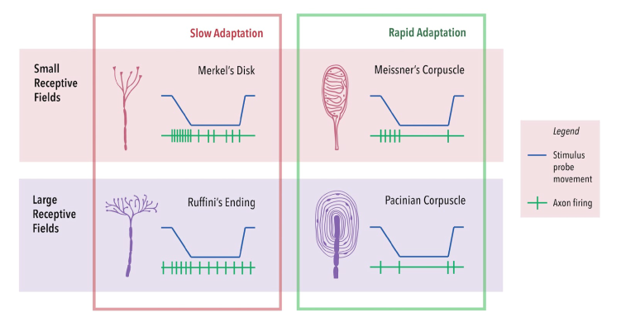
Difference in Mechanoreceptors
Adaptation rate: sensory receptors respond to stimulus, they will eventually become used to the stimulus (adapt to it).
Rapid adaptation (Pacinian, Meissner's), Slow adaptation (Merkel’s, Ruffini)
Receptive field size: sensory receptors have a specific surface area they cover.
Small field (Merkel’s, Meissner's), large field(Pacinian, Ruffini)

Slide 27
Other Receptors
Chemoreceptors
Respond to specific chemicals
Osmoreceptors
Respond to changes in solute concentration and osmotic activity
Skin Thermoreceptors
Respond to specific temperatures and changes in temperatures
Nociceptors
Respond to somatic sensation of pain
Hyperalgesia: increased sensitivity to painful stimuli
Analgesia: an inability to sense pain
Brain has no nociceptors

Slide 28
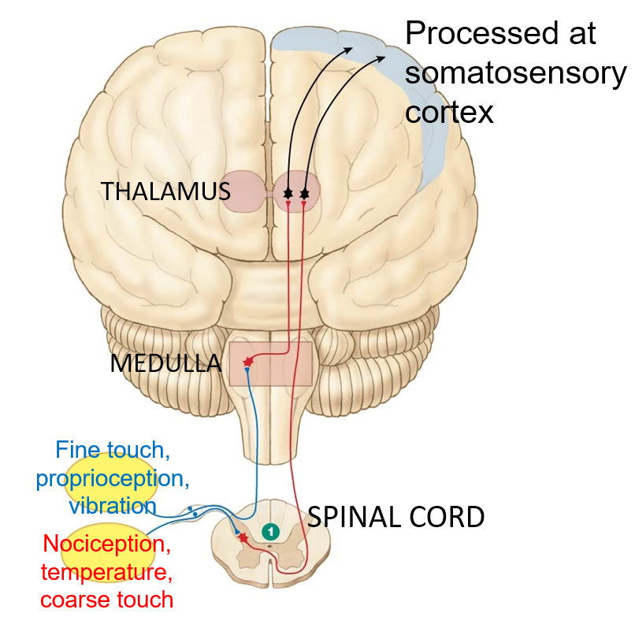
Somatosensory Pathway
Primary sensory neuron carries sensory info (PNS) to the spinal cord (CNS) through the dorsal root
Fine touch, proprioception and vibration stimuli ascend and cross midline at the medulla (secondary sensory neurons)
Nociception, temperature and coarse touch cross midline at spinal cord (secondary sensory neurons)

Slide 29
Which lobe receives incoming somatosensory information?
Located on postcentral gyrus (posterior to central sulcus; parietal lobe)
Somatotopy: body regions correspond to specific points on the brain
Magnification factor: particular body regions are overrepresented
There is plasticity in the somatosensory system (i.e. cortical maps can change)

Slide 30
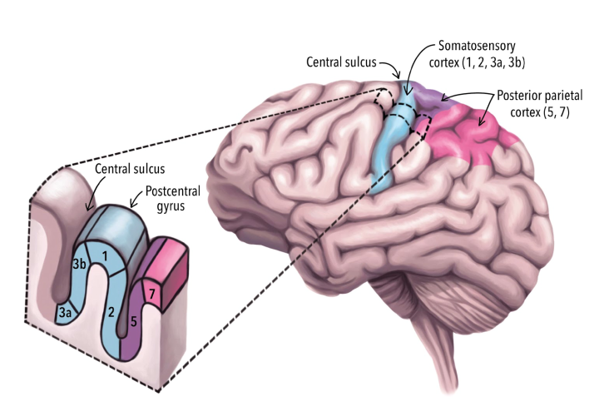
Somatosensory Cortex

Slide 31
Next Tutorial (Oct 15th)
Vision
Audition

Slide 32
What Questions Do You Have?
You can ask in the Owl forums as well!
Also anonymously ask questions in the online dropbox!!

